Slide 1
What is a Bilingual Program?
Classrooms are composed of English speakers and Spanish speakers, and students who speak many other languages as well! The language used for instruction is broken down by a 50/50 ratio.
Fifty percent of classroom instruction is provided in English and fifty percent of classroom instruction is provided in Spanish. All students learn to read, write, listen, and speak two languages equally well.
The bilingual model creates an additive bilingual environment, which allows students to acquire a second or third language while maintaining and developing their native language. The curriculum of the program is the same as in the general education program. All academic areas: reading, language arts, math, science, and social science, are taught in both Spanish and English.
The bilingual program continues through 11th grade.

Slide 2

What are the Goals of the bilingual Program?
Develop high levels of proficiency in Spanish and English
Achieve grade level academic performance in Spanish and English
Increase the use of foreign language among monolingual groups
Develop children who will be more competitive in the global economy
Take advantage of the optimal window of learning a second language during the primary years
Nurture understanding of the different cultures living side by side in Menasha
Give students an upper edge in high school, college, and the workplace
Develop bilingualism, biliteracy, and biculturalism
Develop positive cross-cultural attitudes and behaviors

Slide 3
Why Dual Language?
Cognitive (Brain Based)
Bilingualism increases mental flexibility for children.
Increased analytical orientation to language.
Children who study a second language score higher on verbal standardized tests conducted in English.
Perform better in math and logic skills than children with just one language.
Better self-esteem, creativity, problem-solving skills, and math ability.
Social/emotional/interpersonal
Maintain a strong sense of their own identity while developing sensitivity towards other people and cultures.
Better listeners
Professional
Head start in competition for universities and jobs.
Job opportunities are almost limitless.

Slide 4
Critical Factors for a Successful Program
5
1
3
2
4
Students participate through Middle School
Emphasis in Spanish literacy at Early Grade (k-2) and English beginning in 3rd grade
Follow the same standards as the the rest of the district.
There is a balanced ratio of speakers of each language
Core Academics are emphasized as well as instructional excellence

Slide 5
Application Process and Prioritization
1. Incoming MJSD Kindergarten students who have siblings enrolled in the program.
2. Incoming MJSD Kindergarten students who do not have siblings in the program
3. Students outside the MJSD that currently have siblings enrolled in the program
4. Students from outside the MJSD that do not have siblings in the program
Proceso de solicitud y priorización
1. Alumnos que entran a Kindergarten en MJSD que tienen hermanos inscritos actualmente en el programa
2. Alumnos que entran a Kindergarten en MJSD que no tienen hermanos en el programa
3. Alumnos de fuera de MJSD que tienen hermanos inscritos actualmente en el programa
4. Alumnos de fuera de MJSD que no tienen hermanos en el programa

Slide 6

Sra. Vera, Kindergarten/kindergarten

Slide 7
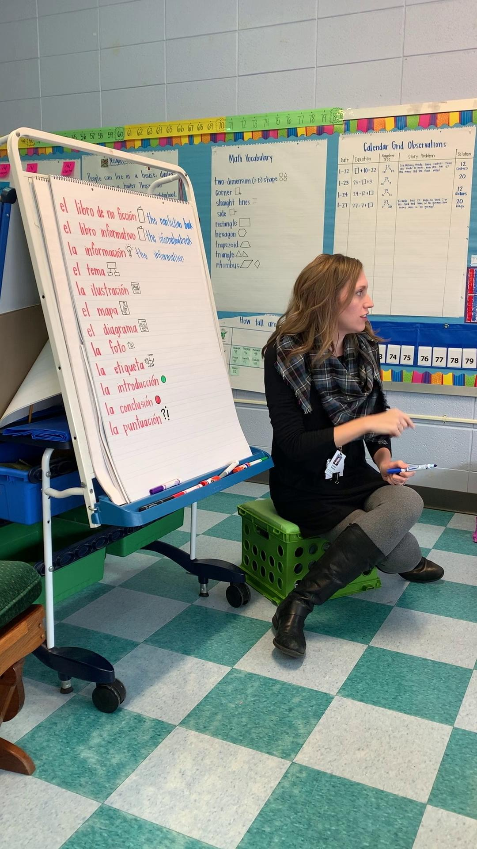
Sra. Weborg, 1st grade / 1^{r} grado

Slide 8
FAQ
Are students screened for the bilingual immersion program?
There is no screening process for entry in the kindergarten classroom. All Students are welcome!!!
Does it matter if no one at home speaks the second language?
No, the program was designed for children of families who do not speak the second language. For this reason written communication is translated into English or Spanish so parents can help reinforce concepts at home.
How will my child understand if he/she does not speak the second language?
In bilingual classrooms, teachers use many strategies to make the content understandable, such as visuals, props, manipulatives, facial expressions, gestures, physical movements, and many other instructional techniques. The teachers also repeat vocabulary and concepts and always check for understanding. REMEMBER, IMMERSION TEACHERS DO NOT EXPECT YOUR CHILD TO SPEAK THE SECOND LANGUAGE RIGHT AWAY. The students are not forced to speak the second language, and they are initially allowed to speak English/Spanish. The teachers will restate what your child says to reinforce the connection between the Spanish and English vocabulary or vice versa.

